Slide 1
BUS 297D: Data Mining
Professor David Mease
Lecture 5
Agenda:
1) Go over midterm exam solutions
2) Assign HW #3 (Due Thurs 10/1)
3) Lecture over Chapter 4

Slide 2
Homework 3
Homework 3 is at
http://www.cob.sjsu.edu/mease_d/bus297D/homework3.html
It is due Thursday, October 1 during class
It is work 50 points
It must be printed out using a computer and turned in during the class meeting time. Anything handwritten on the homework will not be counted. Late homeworks will not be accepted.

Slide 3

Introduction to Data Mining
by
Tan, Steinbach, Kumar
Chapter 4: Classification: Basic Concepts, Decision Trees, and Model Evaluation

Slide 4

Illustration of the Classification Task:
Learning
Algorithm
Model

Slide 5
Classification: Definition
Given a collection of records (training set)
  Each record contains a set of attributes (x), with one additional attribute which is the class (y).
Find a model to predict the class as a function of the values of other attributes.
Goal: previously unseen records should be assigned a class as accurately as possible.
  A test set is used to determine the accuracy of the model. Usually, the given data set is divided into training and test sets, with training set used to build the model and test set used to validate it.

Slide 6




Classification Examples
Classifying credit card transactions
as legitimate or fraudulent
Classifying secondary structures of protein
as alpha-helix, beta-sheet, or random
coil
Categorizing news stories as finance,
weather, entertainment, sports, etc
Predicting tumor cells as benign or malignant

Slide 7
Classification Techniques
There are many techniques/algorithms for carrying out classification
In this chapter we will study only decision trees
In Chapter 5 we will study other techniques, including some very modern and effective techniques

Slide 8

An Example of a Decision Tree
categorical
categorical
continuous
class
Splitting Attributes
Refund
Yes
No
NO
MarSt
Single, Divorced
Married
TaxInc
NO
< 80K
> 80K
NO
YES
Training Data
Model: Decision Tree

Slide 9

Applying the Tree Model to Predict the Class for a New Observation
Test Data
Start from the root of tree.
Refund
Yes
No
NO
MarSt
Single, Divorced
Married
TaxInc
NO
< 80K
> 80K
NO
YES

Slide 10
Applying the Tree Model to Predict the Class for a New Observation
Test Data
Refund
Yes
No
NO
MarSt
Single, Divorced
Married
TaxInc
NO
< 80K
> 80K
NO
YES

Slide 11

Applying the Tree Model to Predict the Class for a New Observation
Test Data
Refund
Yes
No
NO
MarSt
Single, Divorced
Married
TaxInc
NO
< 80K
> 80K
NO
YES

Slide 12
Applying the Tree Model to Predict the Class for a New Observation
Test Data
Refund
Yes
No
NO
MarSt
Single, Divorced
Married
TaxInc
NO
< 80K
> 80K
NO
YES

Slide 13

Applying the Tree Model to Predict the Class for a New Observation
Test Data
Refund
Yes
No
NO
MarSt
Single, Divorced
Married
TaxInc
NO
< 80K
> 80K
NO
YES

Slide 14
Applying the Tree Model to Predict the Class for a New Observation
Test Data
Refund
Yes
No
NO
MarSt
Single, Divorced
Married
Assign Cheat to “No”
TaxInc
NO
< 80K
> 80K
NO
YES

Slide 15
Decision Trees in R
The function rpart() in the library “rpart” generates decision trees in R.
Be careful: This function also does regression trees which are for a numeric response. Make sure the function rpart() knows your class labels are a factor and not a numeric response.
(“if y is a factor then method="class" is assumed”)

Slide 16
In class exercise #32:
Below is output from the rpart() function. Use this tree to predict the class of the following observations:
a) (Age=middle Number=5 Start=10)
b) (Age=young Number=2 Start=17)
c) (Age=old Number=10 Start=6)
1) root 81 17 absent (0.79012346 0.20987654)
2) Start>=8.5 62 6 absent (0.90322581 0.09677419)
4) Age=old,young 48 2 absent (0.95833333 0.04166667)
8) Start>=13.5 25 0 absent (1.00000000 0.00000000) *
9) Start< 13.5 23 2 absent (0.91304348 0.08695652) *
5) Age=middle 14 4 absent (0.71428571 0.28571429)
10) Start>=12.5 10 1 absent (0.90000000 0.10000000) *
11) Start< 12.5 4 1 present (0.25000000 0.75000000) *
3) Start< 8.5 19 8 present (0.42105263 0.57894737)
6) Start< 4 10 4 absent (0.60000000 0.40000000)
12) Number< 2.5 1 0 absent (1.00000000 0.00000000) *
13) Number>=2.5 9 4 absent (0.55555556 0.44444444) *
7) Start>=4 9 2 present (0.22222222 0.77777778)
14) Number< 3.5 2 0 absent (1.00000000 0.00000000) *
15) Number>=3.5 7 0 present (0.00000000 1.00000000) *

Slide 17
In class exercise #33:
Use rpart() in R to fit a decision tree to last column of the sonar training data at
http://www-stat.wharton.upenn.edu/~dmease/sonar_train.csv
Use all the default values. Compute the misclassification error on the training data and also on the test data at
http://www-stat.wharton.upenn.edu/~dmease/sonar_test.csv

Slide 18
In class exercise #33:
Use rpart() in R to fit a decision tree to last column of the sonar training data at
http://www-stat.wharton.upenn.edu/~dmease/sonar_train.csv
Use all the default values. Compute the misclassification error on the training data and also on the test data at
http://www-stat.wharton.upenn.edu/~dmease/sonar_test.csv
Solution:
install.packages("rpart")
library(rpart)
train<-read.csv("sonar_train.csv",header=FALSE)
y<-as.factor(train[,61])
x<-train[,1:60]
fit<-rpart(y~.,x)
1-sum(y==predict(fit,x,type="class"))/length(y)

Slide 19
In class exercise #33:
Use rpart() in R to fit a decision tree to last column of the sonar training data at
http://www-stat.wharton.upenn.edu/~dmease/sonar_train.csv
Use all the default values. Compute the misclassification error on the training data and also on the test data at
http://www-stat.wharton.upenn.edu/~dmease/sonar_test.csv
Solution (continued):
test<-read.csv("sonar_test.csv",header=FALSE)
y_test<-as.factor(test[,61])
x_test<-test[,1:60]
1-sum(y_test==predict(fit,x_test,type="class"))/ length(y_test)

Slide 20
In class exercise #34:
Repeat the previous exercise for a tree of depth 1 by using control=rpart.control(maxdepth=1). Which model seems better?

Slide 21
In class exercise #34:
Repeat the previous exercise for a tree of depth 1 by using control=rpart.control(maxdepth=1). Which model seems better?
Solution:
fit<-
rpart(y~.,x,control=rpart.control(maxdepth=1))
1-sum(y==predict(fit,x,type="class"))/length(y)
1-sum(y_test==predict(fit,x_test,type="class"))/ length(y_test)

Slide 22
In class exercise #35:
Repeat the previous exercise for a tree of depth 6 by using
control=rpart.control(minsplit=0,minbucket=0,
cp=-1,maxcompete=0, maxsurrogate=0,
usesurrogate=0, xval=0,maxdepth=6)
Which model seems better?

Slide 23
In class exercise #35:
Repeat the previous exercise for a tree of depth 6 by using
control=rpart.control(minsplit=0,minbucket=0,
cp=-1,maxcompete=0, maxsurrogate=0,
usesurrogate=0, xval=0,maxdepth=6)
Which model seems better?
Solution:
fit<-rpart(y~.,x,
control=rpart.control(minsplit=0,
minbucket=0,cp=-1,maxcompete=0,
maxsurrogate=0, usesurrogate=0, xval=0,maxdepth=6))
1-sum(y==predict(fit,x,type="class"))/length(y)
1-sum(y_test==predict(fit,x_test,type="class"))/ length(y_test)

Slide 24
How are Decision Trees Generated?
Many algorithms use a version of a “top-down” or “divide-and-conquer” approach known as Hunt’s Algorithm (Page 152):
Let D_{t} be the set of training records that reach a node t
  If D_{t} contains records that belong the same class y_{t}, then t is a leaf node labeled as y_{t}
  If D_{t} contains records that belong to more than one class, use an attribute test to split the data into smaller subsets. Recursively apply the procedure to each subset.

Slide 25

An Example of Hunt’s Algorithm
Refund
Don’t
Cheat
Yes
No
Don’t
Cheat
Don’t
Cheat
Refund
Refund
Yes
No
Yes
No
Don’t
Cheat
Marital
Status
Don’t
Cheat
Marital
Status
Single,
Divorced
Single,
Divorced
Married
Married
Cheat
Don’t
Cheat
Taxable
Income
Don’t
Cheat
< 80K
>= 80K
Don’t
Cheat
Cheat

Slide 26
How to Apply Hunt’s Algorithm
Usually it is done in a “greedy” fashion.
“Greedy” means that the optimal split is chosen at each stage according to some criterion.
This may not be optimal at the end even for the same criterion.
However, the greedy approach is computational efficient so it is popular.

Slide 27
How to Apply Hunt’s Algorithm (continued)
Using the greedy approach we still have to decide 3 things:
    #1) What attribute test conditions to consider
    #2) What criterion to use to select the “best” split
    #3) When to stop splitting
For #1 we will consider only binary splits for both numeric and categorical predictors as discussed on the next slide
For #2 we will consider misclassification error, Gini index and entropy
#3 is a subtle business involving model selection. It is tricky because we don’t want to overfit or underfit.

Slide 28
#1) What Attribute Test Conditions to Consider (Section 4.3.3, Page 155)
We will consider only binary splits for both numeric and categorical predictors as discussed, but your book talks about multiway splits also
Nominal
Ordinal – like nominal but don’t break order with split
Numeric – often use midpoints between numbers
CarType
{Sports, Luxury}
{Family}
Size
Size
OR
{Medium,
Large}
{Small, Medium}
{Small}
{Large}
Taxable
Income > 80K?
Yes
No

Slide 29



#2) What criterion to use to select the “best” split (Section 4.3.4, Page 158)
We will consider misclassification error, Gini index and entropy
Misclassification Error:
Gini Index:
Entropy:

Slide 30
Misclassification Error
Misclassification error is usually our final metric which we want to minimize on the test set, so there is a logical argument for using it as the split criterion
It is simply the fraction of total cases misclassified
1 - Misclassification error = “Accuracy” (page 149)

Slide 31
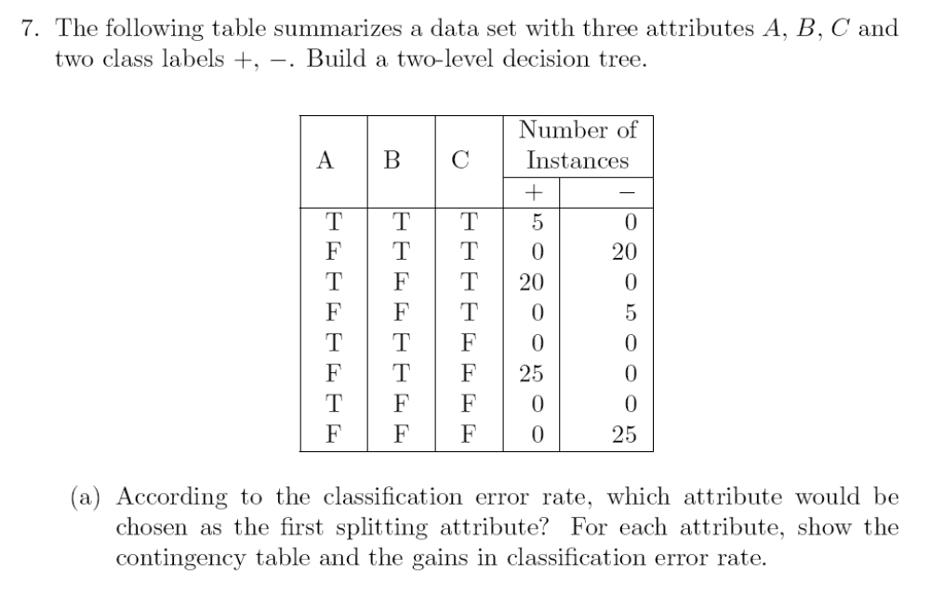
In class exercise #36:
This is textbook question #7 part (a) on page 201.

Slide 32

Gini Index
This is commonly used in many algorithms like CART and the rpart() function in R
After the Gini index is computed in each node, the overall value of the Gini index is computed as the weighted average of the Gini index in each node

Slide 33



Gini Examples for a Single Node
P(C1) = 0/6 = 0 P(C2) = 6/6 = 1
Gini = 1 – P(C1)² – P(C2)² = 1 – 0 – 1 = 0
P(C1) = 1/6 P(C2) = 5/6
Gini = 1 – (1/6)² – (5/6)² = 0.278
P(C1) = 2/6 P(C2) = 4/6
Gini = 1 – (2/6)² – (4/6)² = 0.444

Slide 34
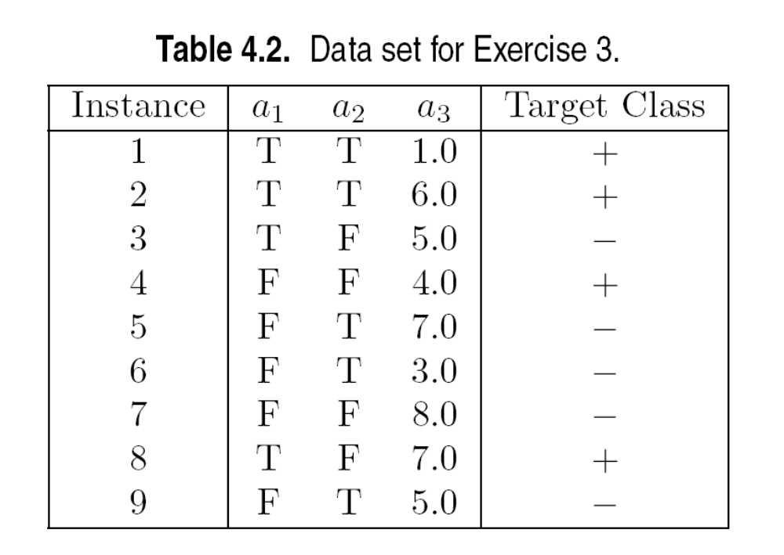
In class exercise #37:
This is textbook question #3 part (f) on page 200.

Slide 35
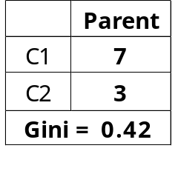
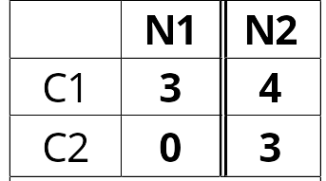
Misclassification Error Vs. Gini Index
The Gini index decreases from .42 to .343 while the misclassification error stays at 30%. This illustrates why we often want to use a surrogate loss function like the Gini index even if we really only care about misclassification.
A?
Gini(N1)
= 1 – (3/3)² – (0/3)²
= 0
Gini(N2)
= 1 – (4/7)² – (3/7)²
= 0.490
Yes
No
Node N1
Node N2
Gini(Children)
= 3/10 * 0
+ 7/10 * 0.49
= 0.343

Slide 36

Entropy
Measures purity similar to Gini
Used in C4.5
After the entropy is computed in each node, the overall value of the entropy is computed as the weighted average of the entropy in each node as with the Gini index
The decrease in Entropy is called “information gain” (page 160)

Slide 37
Entropy Examples for a Single Node
P(C1) = 0/6 = 0 P(C2) = 6/6 = 1
Entropy = – 0 log 0 – 1 log 1 = – 0 – 0 = 0
P(C1) = 1/6 P(C2) = 5/6
Entropy = – (1/6) log₂ (1/6) – (5/6) log₂ (5/6) = 0.65
P(C1) = 2/6 P(C2) = 4/6
Entropy = – (2/6) log₂ (2/6) – (4/6) log₂ (4/6) = 0.92

Slide 38
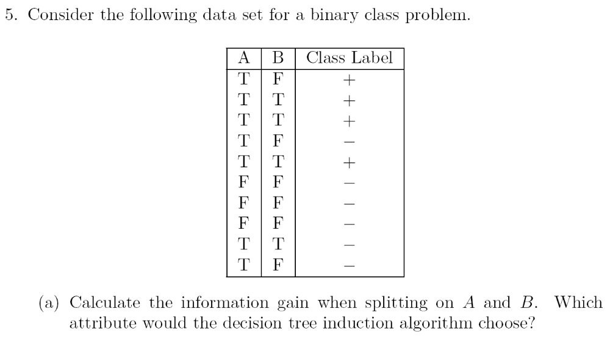
In class exercise #38:
This is textbook question #5 part (a) on page 200.

Slide 39
In class exercise #39:
This is textbook question #3 part (c) on page 199.

Slide 40

A Graphical Comparison

Slide 41
#3) When to stop splitting
This is a subtle business involving model selection. It is tricky because we don’t want to overfit or underfit.
One idea would be to monitor misclassification error (or the Gini index or entropy) on the test data set and stop when this begins to increase.
“Pruning” is a more popular technique.

Slide 42
Pruning
“Pruning” is a popular technique for choosing the right tree size
Your book calls it post-pruning (page 185) to differentiate it from prepruning
With (post-) pruning, a large tree is first grown top-down by one criterion and then trimmed back in a bottom up approach according to a second criterion
Rpart() uses (post-) pruning since it basically follows the CART algorithm
(Breiman, Friedman, Olshen, and Stone, 1984, Classification and Regression Trees)

